Slide 1
TOPICS OF DISCUSSION
Types of Java applications
MVC Design pattern
What is Monolithic Architecture and It’s Drawbacks
Why to Use Microservice Architecture?
Introduction to microservices Architecture
Advantages of microservices
Challenges in Microservices Implementation and How to Resolve It
A Sample Microservices Architecture
Presenter : Chalapathirao Davala

Slide 2
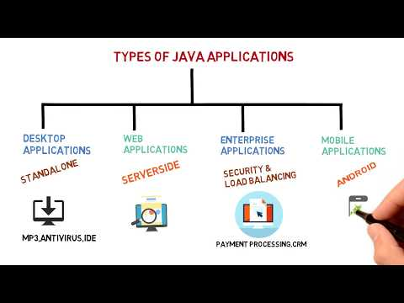
TYPES OF JAVA APPLICATIONS

Slide 3
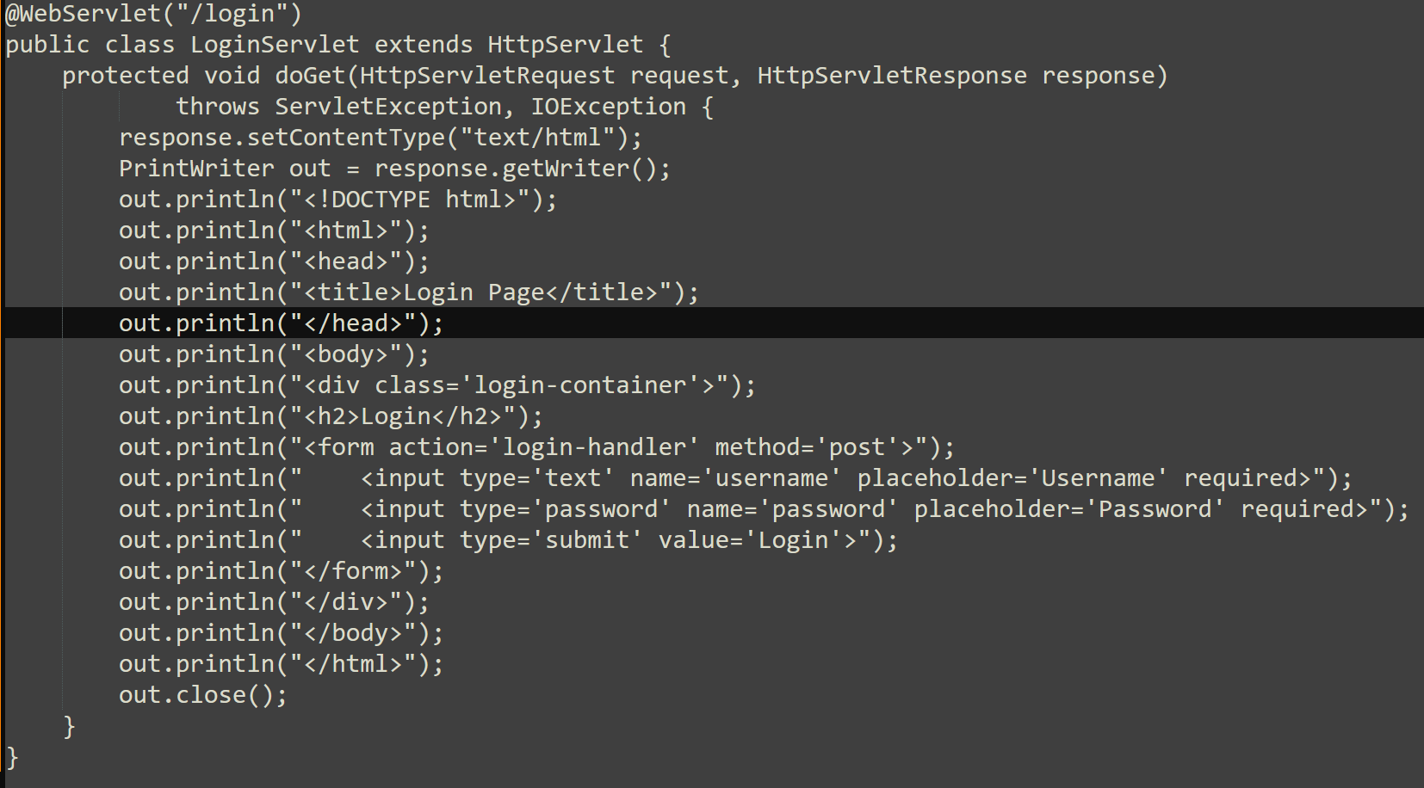
Sample Servlet Code for monolithic application

Slide 4
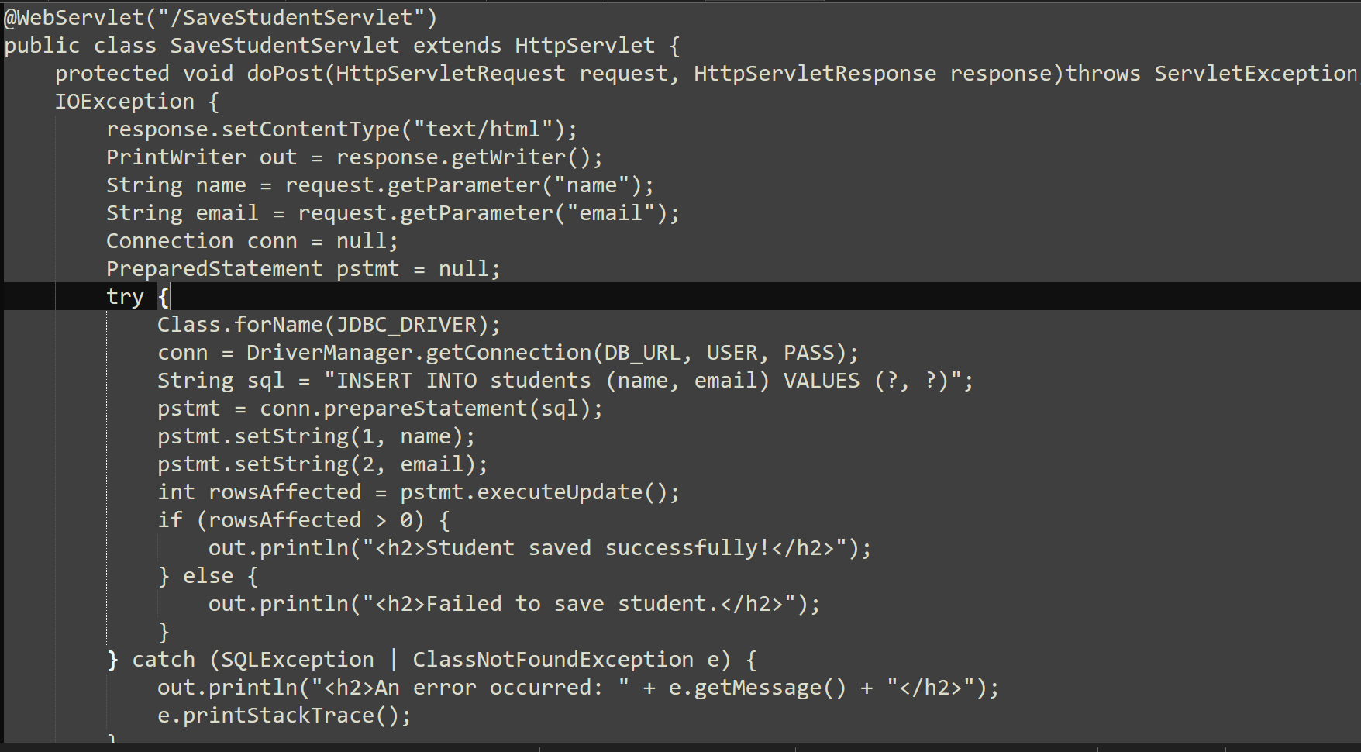
Sample Servlet Code for monolithic application

Slide 5
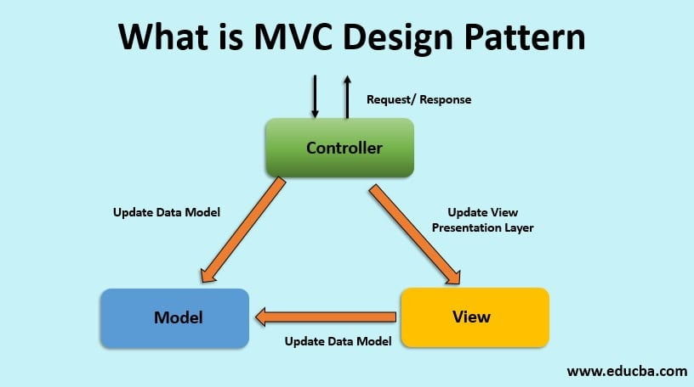
MVC Design Pattern

Slide 6
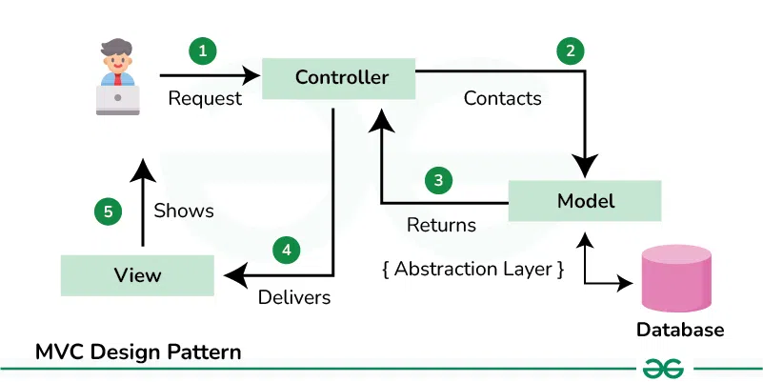
MVC Design Pattern

Slide 7
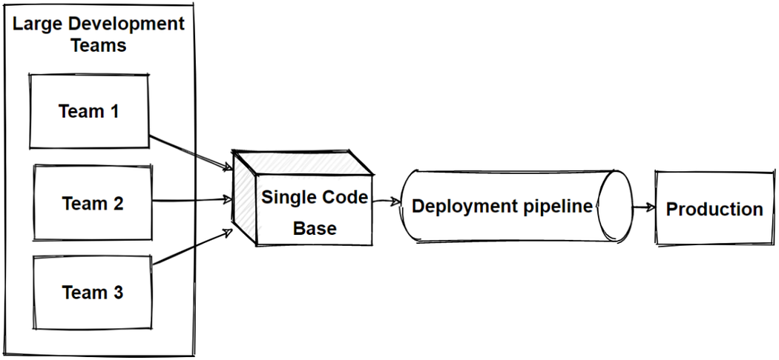
Monolithic Architecture

Slide 8
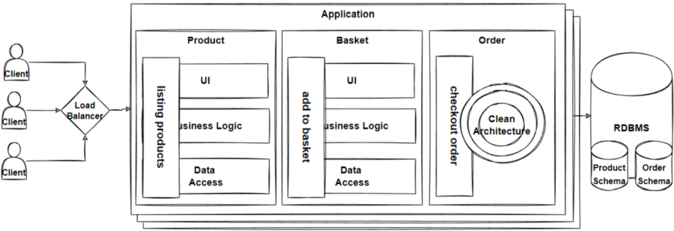
Monolithic Architecture

Slide 9
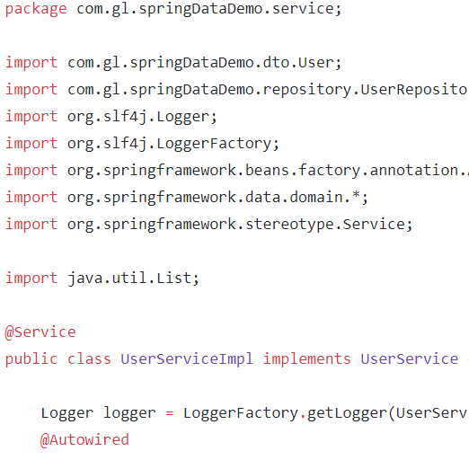

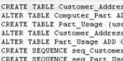
Online Shopping Portal
C
O
N
T
R
O
L
E
R
L
A
Y
E
R
D
A
O
L
A
Y
E
R
Product Management
Database
Account Management
Payment Management
Login Management
Order Management

Slide 10
Advantage of Monolithic Architecture
Simplicity in Development
Single code base
Single Deployment
Performance is good
Easier Testing
Centralized Management
Centralized Control Flow
Central Data Store
Easier Debugging

Slide 11
Drawbacks of Monolithic Architecture
Maintenance Complexity- Large monolithic code base is very difficult to understand
Overloaded Web Container and Overloaded IDE
Deployment Risks- Frequent deployment is difficult
Limited Scalability- Scaling the application is difficult
Tight Coupling - changes may affect
Slower Deployment-
Not Suitable for Large applications or teams
Slower Adaptation – new technology enhancements
It’s not fault tolerant – failure in one may affect entire system

Slide 12
Why Microservice Architecture?
Code base is better understandable
Highly maintainable and testable - enables rapid and frequent
development and deployment are independent
Loosely coupled with other services so independently deployable
Improved fault isolation
Adapting new technologies is easier
The faster IDE makes developer more productive

Slide 13
Fundamental problems with Monoliths which can’t be solved without changing the architecture??
Response to change – bug fix or adding new feature
On demand scaling
Flexibility
Adopting new technologies for better performance

Slide 14
What are Microservices?
Monolithic Architecture Microservices Architecture
Application A
Application a1
Application a2
Application a3
Application a4

Slide 15


Online Shopping Portal
Database
G
A
T
E
W
A
Y
Product Management
Database
Order Management
Database
Account Management
Database
Payment Management
Login Management
Database

Slide 16
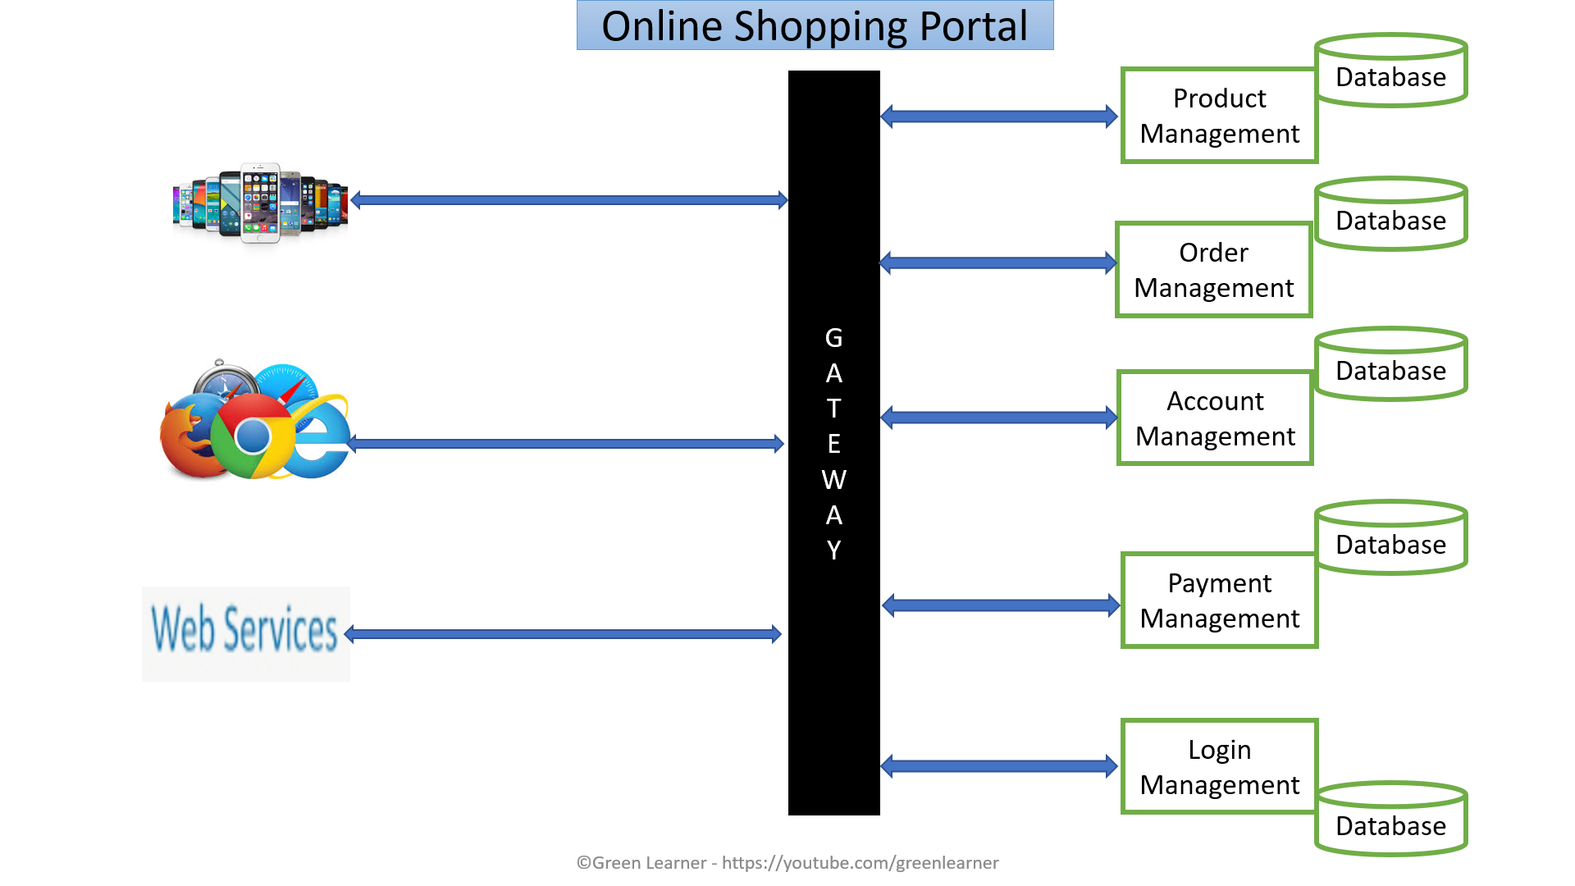
Microservices : Positive aspects
Domain expertise
Easy and quick to scale – on demand
Self Organisation
Quick response to change
Always availibility
Can experiment with any tech
Loose coupling
Service reusability
Agile, SCRUM
Best for large scale apps

Slide 17
Aspect/Feature | Monolithic Architecture | Microservice Architecture
Structure | Single unified codebase | Collection of loosely coupled services
Deployment | Entire application is deployed together/ one war Continuous deployment is difficult | Each service can be deployed independently. Many (per service)- Continuous deployment is easy.
Scalability | Scales as a whole | Scales individual services based on demand
Performance | Faster (in-process) | Slower (network calls)
Technology Stack | Typically uses a single stack | Each service can use different technologies
Development Speed | Faster for small applications | Faster for large teams working in parallel
Fault Isolation | A bug can affect the entire system- Single point failure | Failures are isolated to individual services
Team Size | Small teams | Large, distributed teams
Testing | Easier for end-to-end testing | Requires testing of each service and their interactions
Complexity | Simpler to build and manage initially | More complex due to distributed nature
Data Management | Centralized database | Each service may manage its own database
Communication | Internal function calls | API calls or messaging systems
Maintenance | Harder as the codebase grows | Easier to maintain and evolve individual services
Team Autonomy | Less autonomy; teams work on the same codebase | More autonomy; teams own and manage their services independently
Best Use Case | Simple, small to medium apps | Complex, large-scale, enterprise apps

Slide 18
Microservices :Challenges
Additional complexity with distributed systems
Deployment complexity
Monitoring complexity
Increased resource consumption
Communication among services is challenging
Testing each service is also a challenge

Slide 19
Challenges in Microservices Implementation and Solutions
Discovering all the running services and their instances
Eureka Naming Server by Netflix OSS
Taking care of multiple service calls
Rest Template/ web client by Spring Frameworks
Feign Client by Netflix OSS
Finding easier way of load balancing
Ribbon by Netflix OSS/ spring cloud load balancer.
Maintaining configuration of multiple services
Spring Cloud Config Server
Monitoring all the incoming requests to all the services
Zuul API Gateway/ spring cloud API Gateway by Netflix OSS
Handling Fault Tolerance
Hystrix/ Resilience4j By Netflix OSS

Slide 20
TOPICS OF DISCUSSION
Microservice communication
API Gate way design pattern
Strangler Design pattern
Database per service problems
CQRs
SAGA
Saga Choreography
Saga Orchestrator
Singleton design pattern
A Sample Microservices Architecture
Presenter : Chalapathirao Davala

Slide 21
How Microservices Communicate with Each Other??
How to connect 2 services?
How to process the request & response?
Network latency
HTTP
Hyper Text Transfer Protocol
RPC
Remote Procedure Call
Messaging
XML
Extensible Mark-up Language
JSON
Java Script Object Notation
Synchronous
Asynchronous

Slide 22
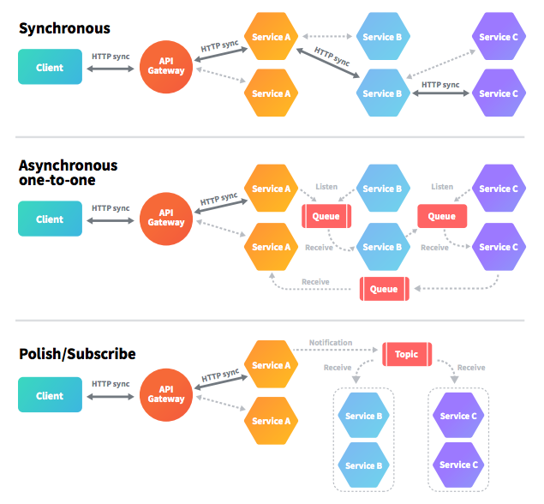
Communicating Between Microservices

Slide 23
Synchronous
Asynchronous
Easy to implement
Easy to test
Easy to debug
Blocking
Slow due to waiting
High coupling
Reliable due to response
Difficult due to message broker
Difficult to test
Difficult to debug
Non-blocking
Fast
Loose coupling
Not Reliable due to no-response

Slide 24


Microservice B
Microservice A
Queue 1
Microservice C
Queue 2
Microservice D

Slide 25


Microservice B
Microservice A
Queue 1
Microservice C
Queue 2
Microservice D

Slide 26


Microservice B
Microservice A
Topic 1
Microservice C
Topic 2
Microservice D

Slide 27


API GATEWAY(Backend for frontend-BFF)
Online Shopping Portal
Product Service
Single entry point
Payment Service
Single entry point
Order Service
Single entry point
3rd party service
Inventory Service

Slide 28
API Gateway use cases
Aggregating data from multiple services
Reduces the request roundtrips
Non-web friendly protocol
Client is able to use single standard protocol to communicate to API gateway and independent of what protocol is used in specific service
How to handle the change in location(host + port) of services
Not the headache of client
Cross cutting concerns like (All of these are now responsibility of API gateway, centralized/clean/standard code)
Security(Authentication & Authorization)
Logging, tracing
Load balancing
Caching
IP whitelisting
Request/response transformations
Failure handling – circuit breaker
Rate limiting.
Addressing the needs of different clients like desktop, mobile or any other service
High coupling for each client
Now each client has it’s own optimal API gateway

Slide 29

API Gateway In Spring cloud
Zuul API/ spring cloud Gateway Server
Ms-B
Client
Ms-C
Ms-A
Ms-D

Slide 30
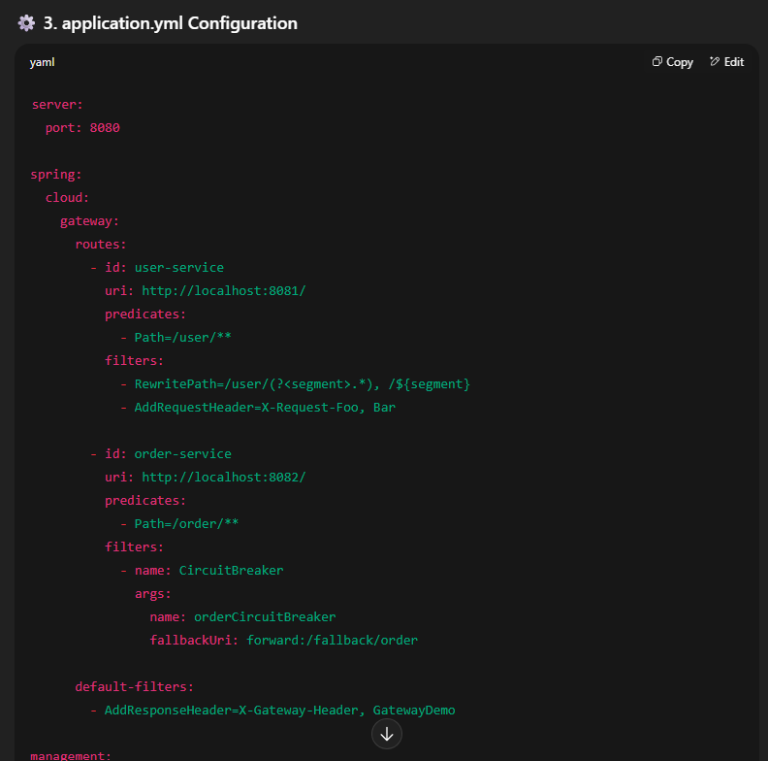
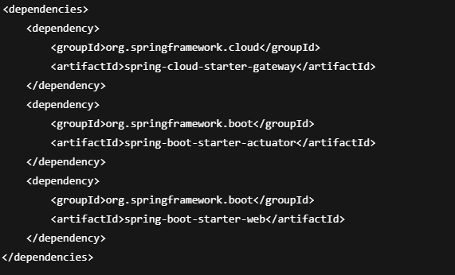
Implementing API Gateway in spring cloud

Slide 31
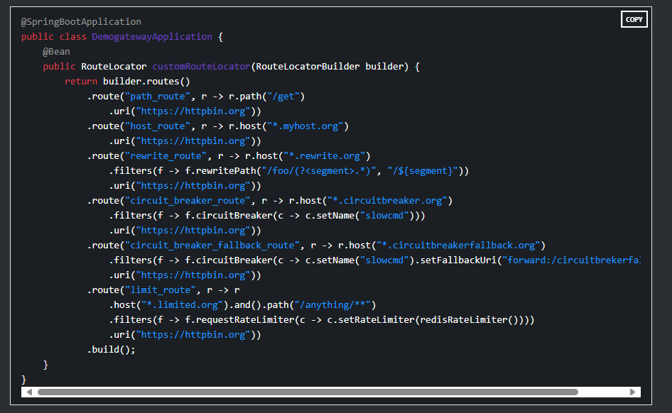
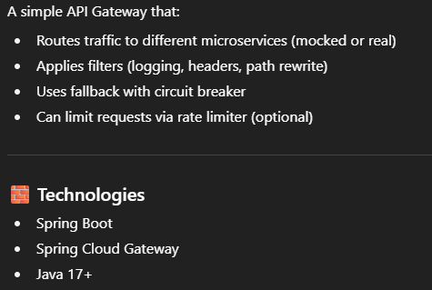
Implementing API Gateway in spring cloud

Slide 32

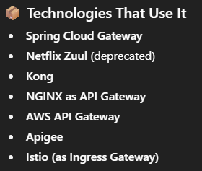
Advantages and Technologies we use in API Gateway
Single Entry Point
Encapsulates Service Details
Supports Cross-Cutting Concerns
Enables Routing and Composition
Improves Security
Easy to Implement Versioning
Centralized Error Handling & Fallback
Reduced Load on Services
Scalability and Flexibility
Supports Strangler Pattern

Slide 33
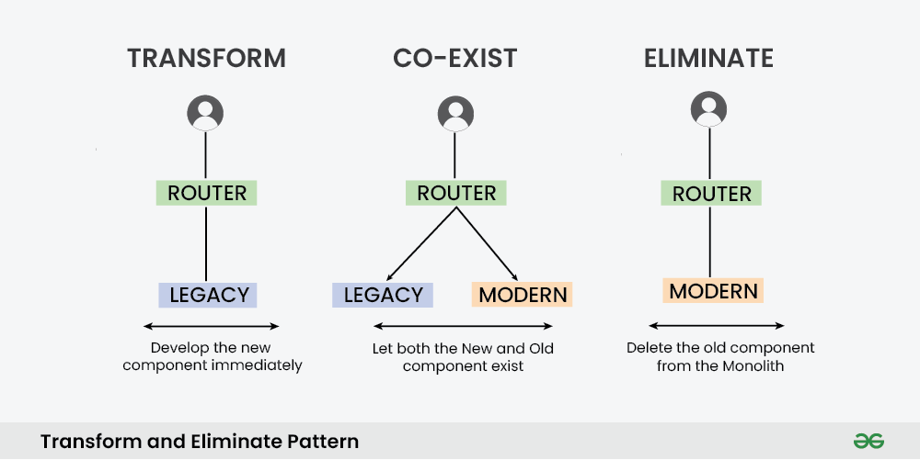
Strangler Pattern

Slide 34
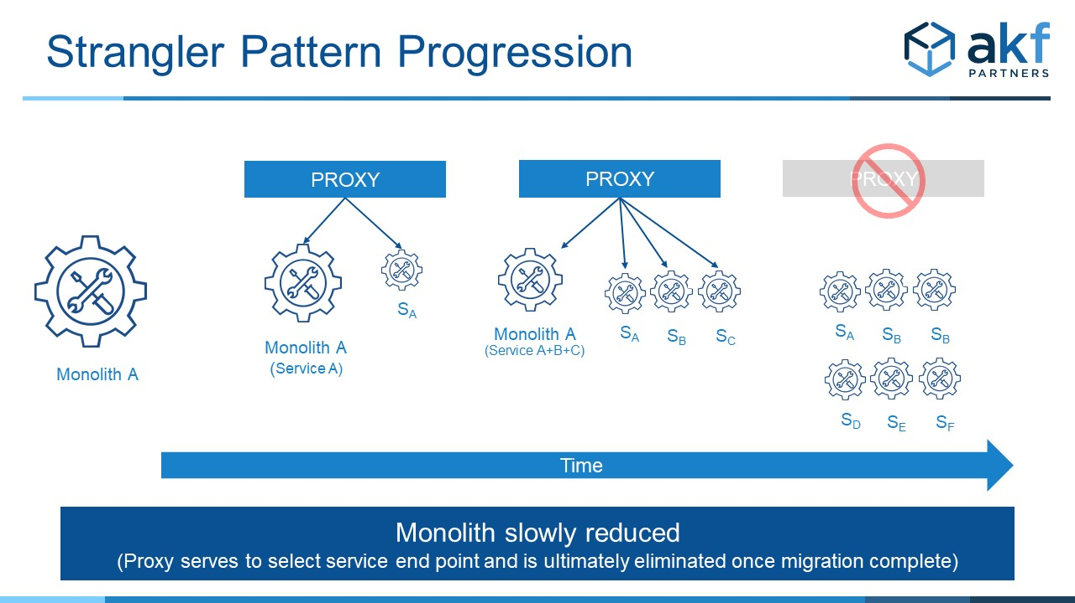

Slide 35
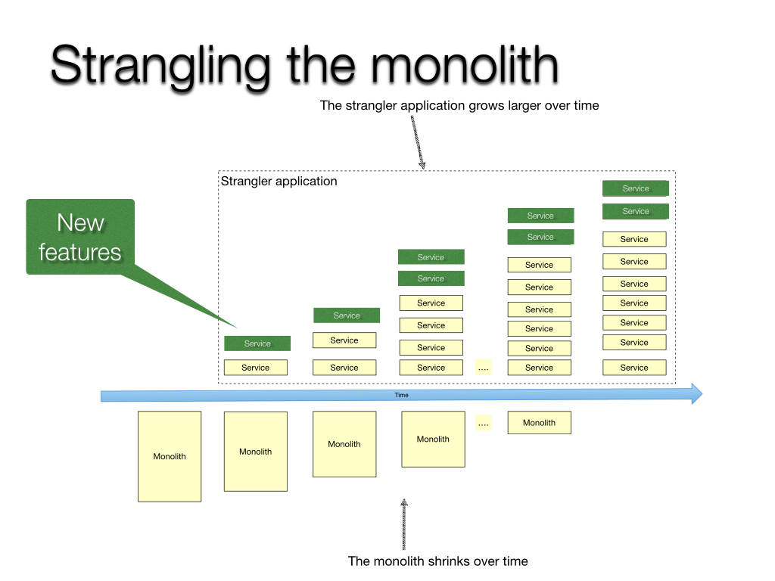

Slide 36
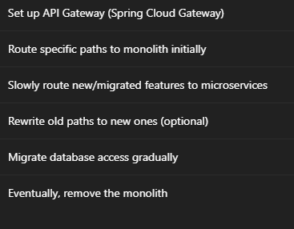
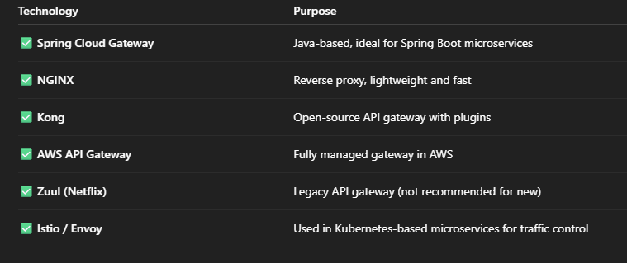
Process and Technologies we use in strangler

Slide 37
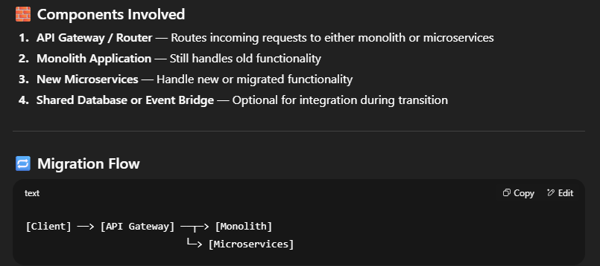

Slide 38
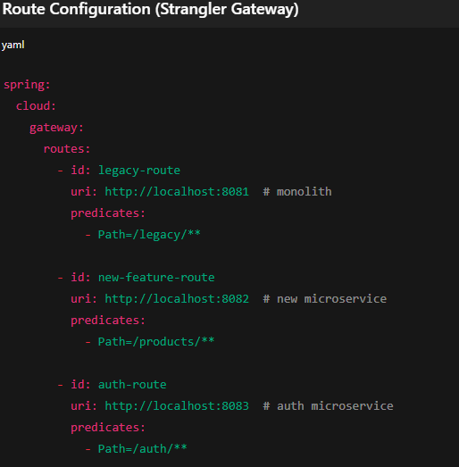
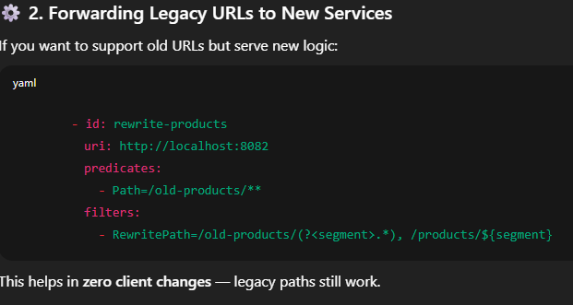

Slide 39
Database Per service

Slide 40
Database Per service
Benefits
Loosely coupled
Free to choose database type e.g. RDBS, mongo Cassandra etc.
if you are using a relational database then the options are:
Private-tables-per-service –
each service owns a set of tables that must only be accessed by that service
Schema-per-service –
each service has a database schema that’s private to that service
Database-server-per-service –
each service has it’s own database server.

Slide 41
Database Per service
Challenges
Queries that needs join over multiple database
Transactions across multiple databases
Solutions
Queries that needs join over multiple database
CQRS
Event Sourcing
API Compositions
Transactions across multiple databases
Saga Pattern ()

Slide 42
What next??
Database Pattern : CQRS

Slide 43
CQRS
Create
Update
Delete
Command
Query
Responsibility
Segregation
View Only

Slide 44
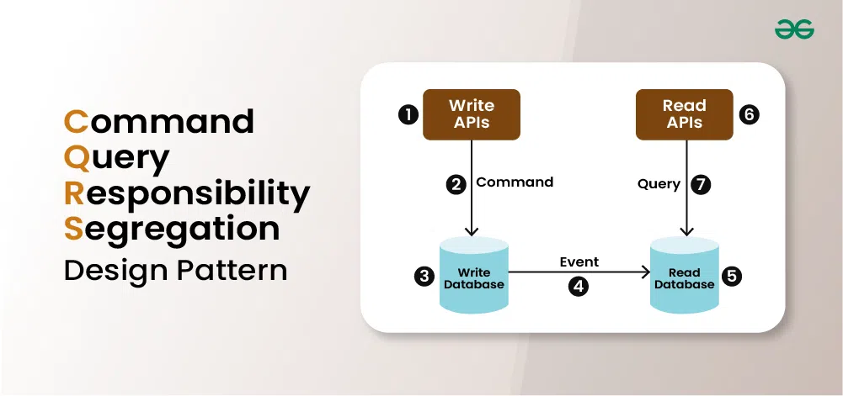

Slide 45
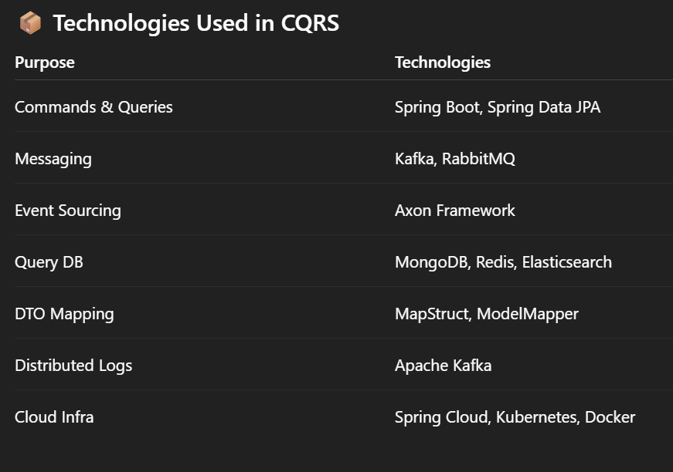
CQRS advantages & used Technologies
Independent scaling
Optimized data schemas
Security
Separation of concerns.
Simpler queries
Different databases for command and query
Flexibility and easy maintenance

Slide 46
CQRS : Challenges
How the data will come to History Service Database?
Events
Database replication methods
Replication delay
Extra complexity
Code Duplication

Slide 47
TOPICS OF DISCUSSION
SAGA Design pattern
Types and Saga Implementation
Service Discovery & Netflix Eureka Server
Load balancing & Spring cloud load balancer
Spring cloud Config server
Folt tolerant with Resilience 4j
A sample Microservice architecture.
Demo.
Presenter : Chalapathirao Davala

Slide 48
What next??
Database Pattern : Saga
For complete course plan about microservice architecture checkout - https://github.com/greenlearner01/Microservices-Architecture

Slide 49
Problem Statement
Transaction
Single unit of logic or work
Spread across multiple services in distributed systems
History Service
Transactions must be
Atomic
Consistent
Isolated
Durable
Mailing Service
Analytics Service
Within a single service maintaining ACID properties for transactions are easy, but
Cross-service transaction requires a cross-service transaction management strategy.

Slide 50
What is Saga?
It’s a way to manage data consistency across microservices in distributed transaction scenarios.
It’s a sequence of transactions that updates each service and publishes a message or event to trigger the next transaction step.
If a step fails, the saga executes compensating transactions that counteract the preceding transactions.

Slide 51
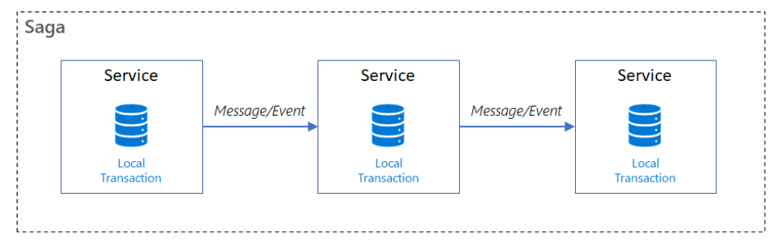
Saga
Sequence of local transactions
Each local transaction updates the database and published the event for next service
If any of the local transaction fails then saga publishes COMPENSATING transactions to all the services which have performed commit

Slide 52
Saga patterns have -
Compensable transactions are transactions that can potentially be reversed by processing another transaction with the opposite effect.
A pivot transaction is the go/no-go point in a saga. If the pivot transaction commits, the saga runs until completion. A pivot transaction can be a transaction that is neither compensable nor retryable, or it can be the last compensable transaction or the first retryable transaction in the saga.
Retryable transactions are transactions that follow the pivot transaction and are guaranteed to succeed.

Slide 53
Saga Implementation
Choreography
Orchestration

Slide 54
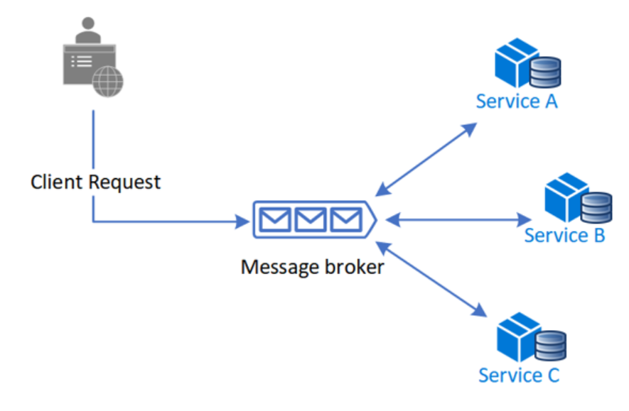
Choreography
Benefits
good for simple workflows which have few services
No additional service
No single point of failure
Drawbacks
Can be confusing when adding new steps
Cyclic dependency risk
Integration testing is difficult

Slide 55
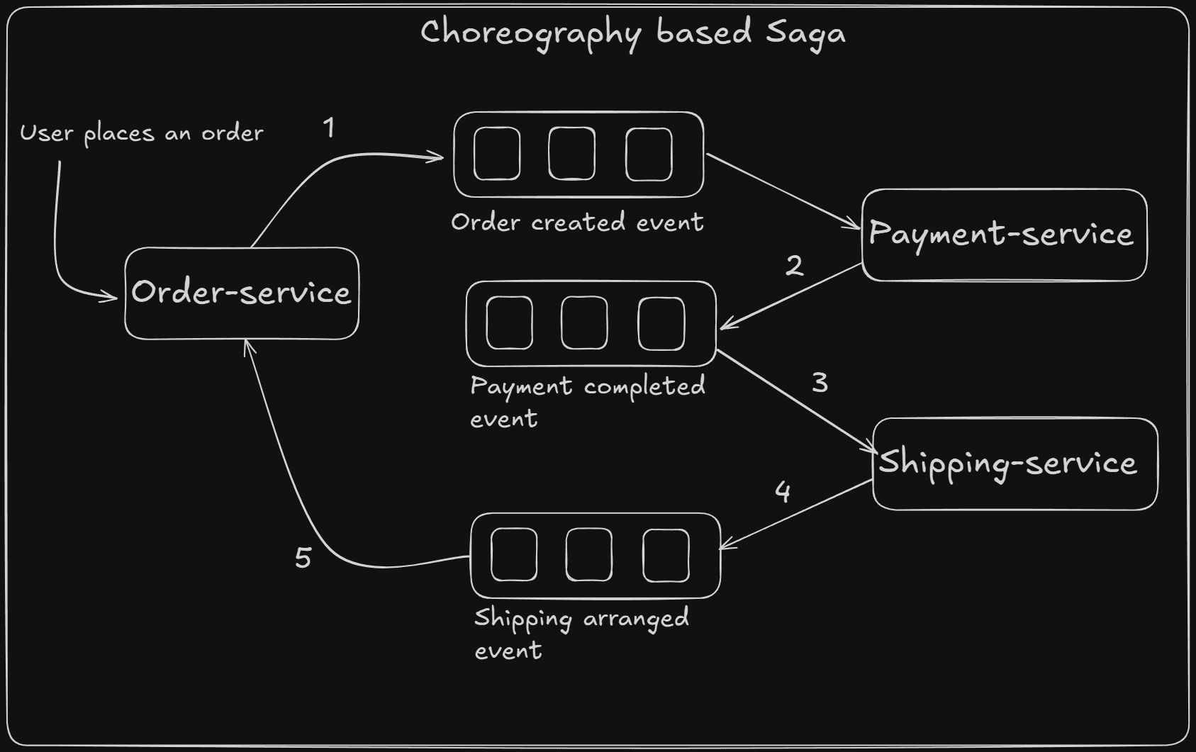
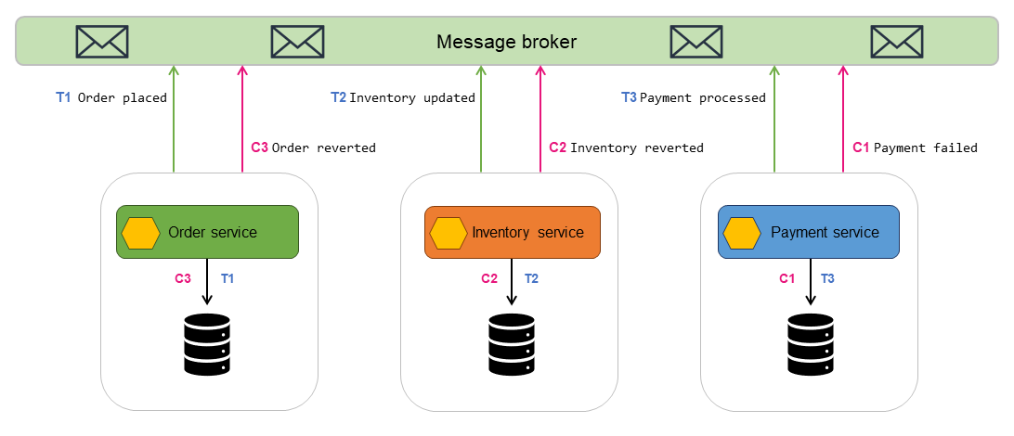
Choreography

Slide 56
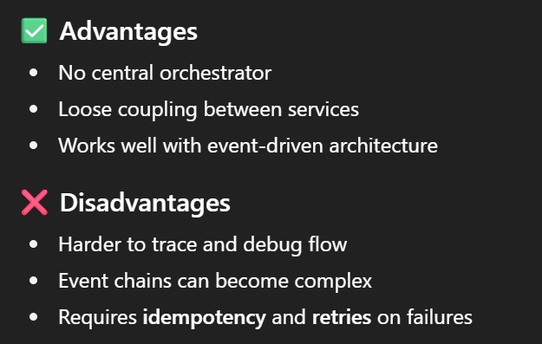
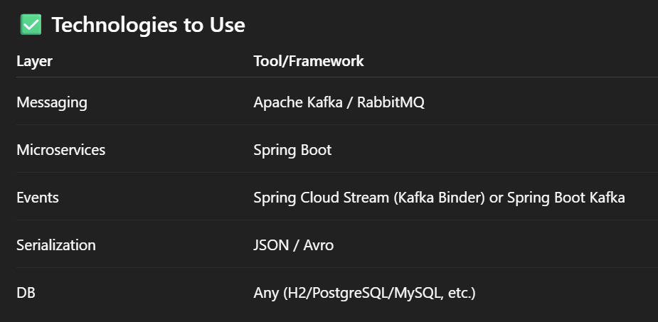
Advantages of Choreography & technology used

Slide 57
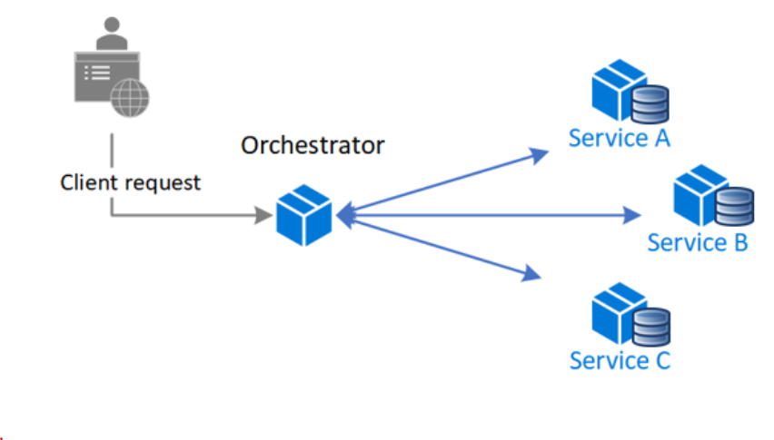
Orchestration
Benefits
good for complex workflows which have many services and new service can be added at any time
Suitable when there is control over all participants and control over the flow of activities
No Cyclic dependency risk
Clear separation of concern, separate from business logic
Drawbacks
Additional design complexity
Additional point of failure

Slide 58
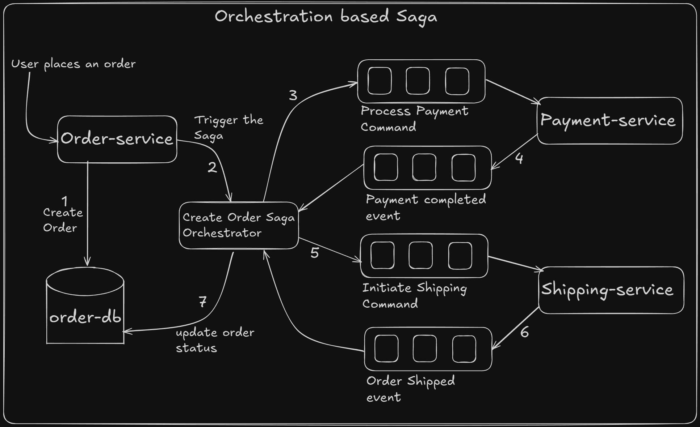
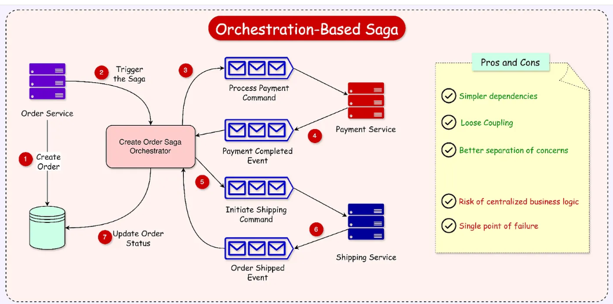

Slide 59
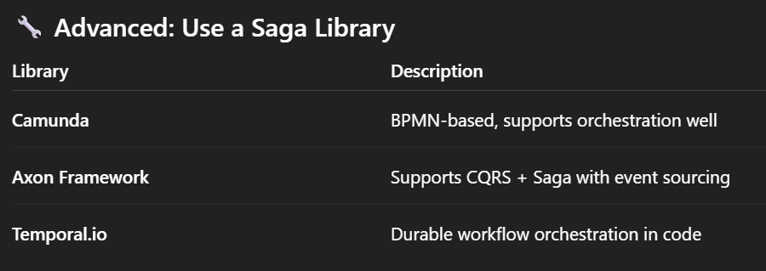
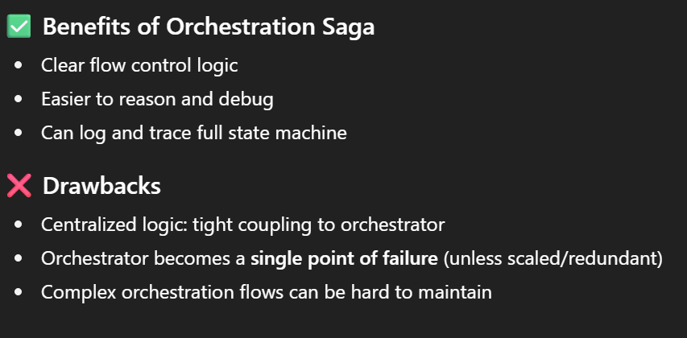
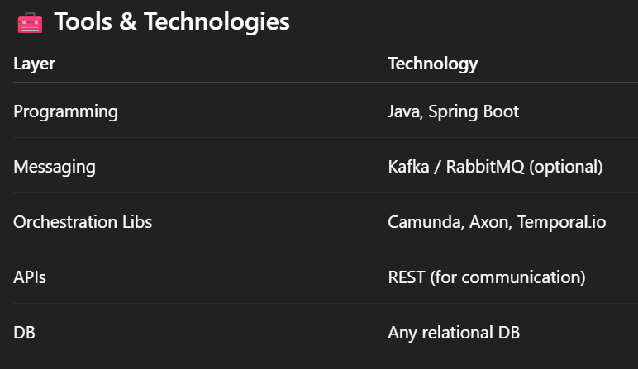

Slide 60
What is Service Discovery?
Eureka
Eureka Naming Server
(port:8761)
Ms-A running on port 8081
Ms-B running on port 8082
Ms-C running on port 8083 & 8084
http://localhost:8761
Ms-A
(8081)
Ms-B
(8082)
Ms-C
(8083)
Ms-C
(8084)

Slide 61
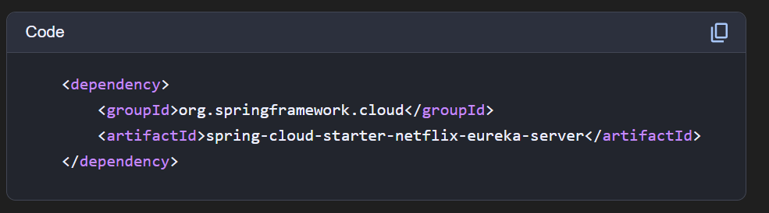
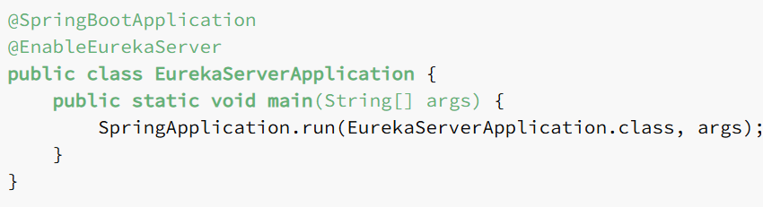
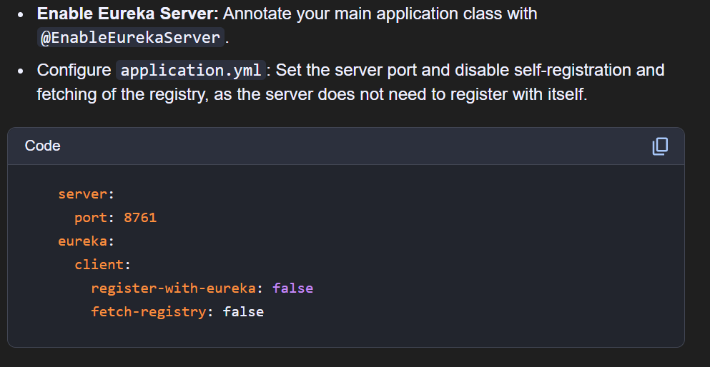
Eureka Server

Slide 62
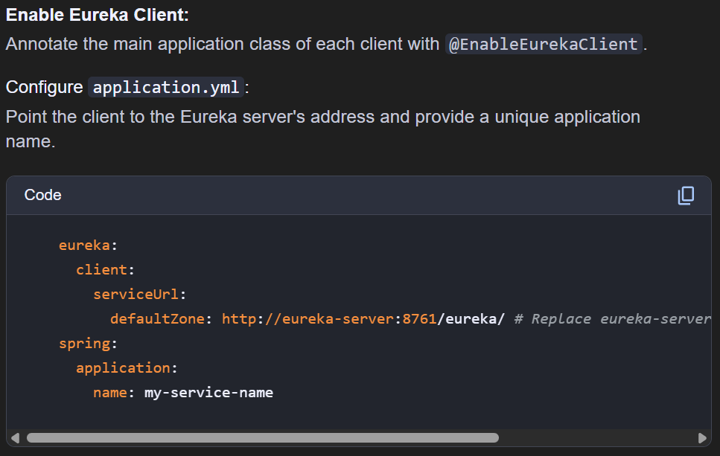
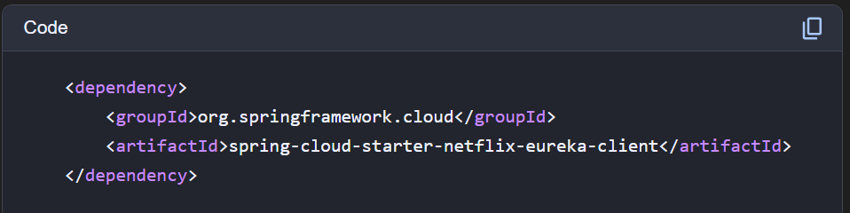
Eureka Client (Microservice) Applications

Slide 63
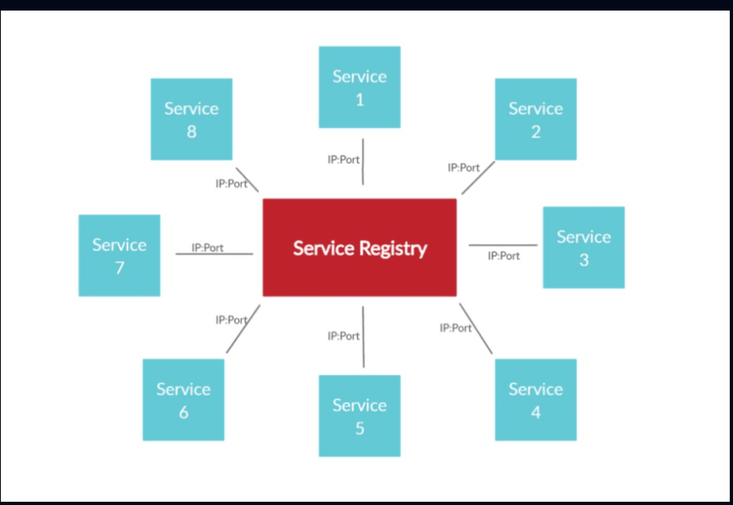
Multiple microservices registering Eureka Server

Slide 64
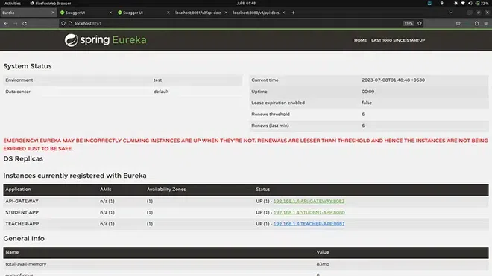
Spring Eureka Server

Slide 65
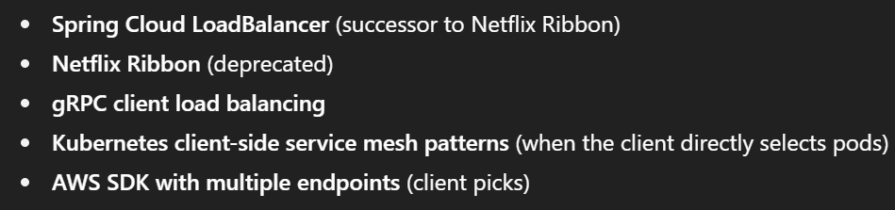
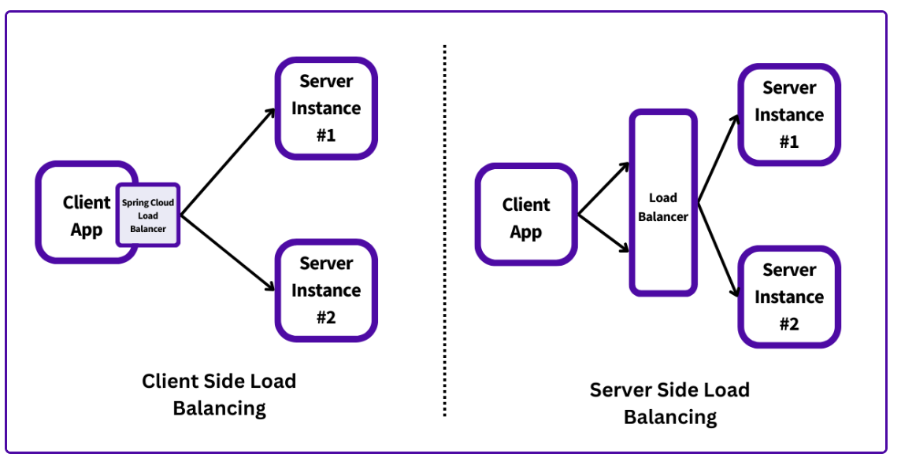
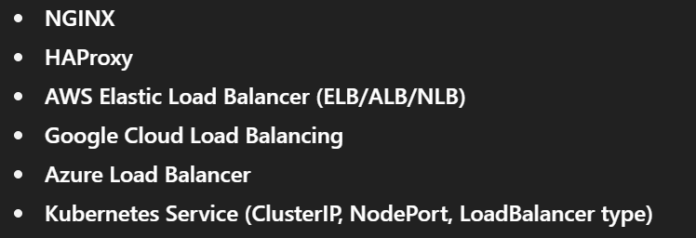
Load Balancing

Slide 66
Calling Another Microservice and Load Balancing
Eureka Naming Server
Ms-B
(9092)
1st and 4th call
Ms-A
(9091)
Ribbon /spring cloud LB
Ms-B
(9093)
2nd call
Client
3rd call
Ms-B
(9094)

Slide 67
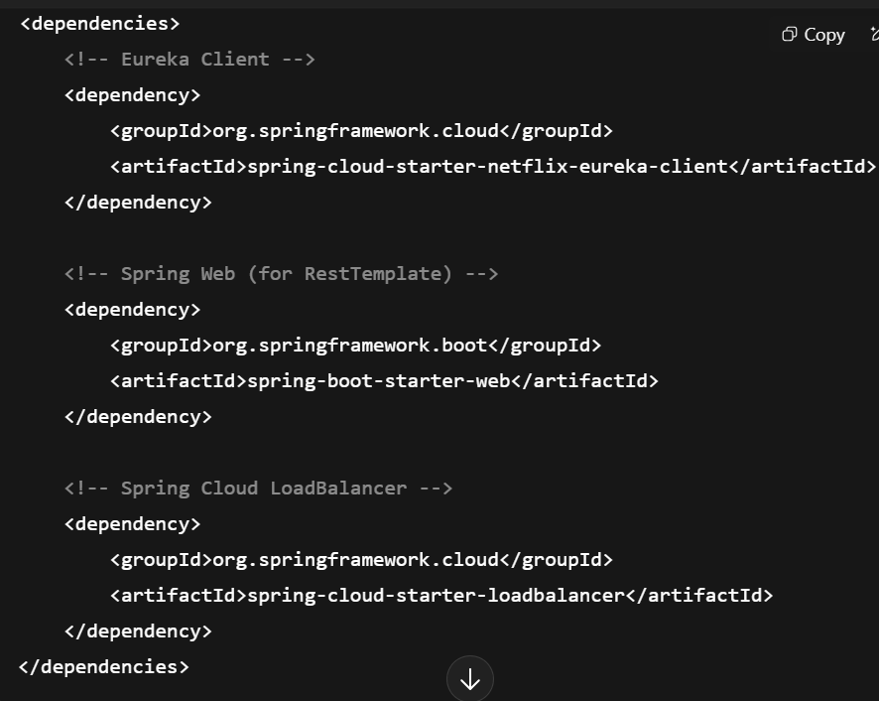
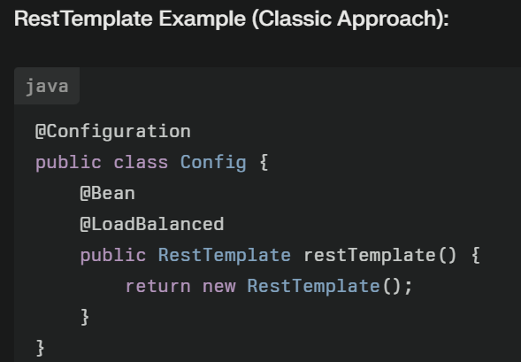


Spring cloud Load Balancer with Eureka, Rest Template client

Slide 68



Spring cloud Load Balancer with Eureka and Web client

Slide 69




Spring cloud Load Balancer with Eureka and Feign client

Slide 70
Centralized Configuration By Config Server
Storing All Configurations in a GIT Repository
Ms-A
Spring Cloud Config Server
GIT Repo
Ms-B
Ms-C

Slide 71

Spring cloud Config Server and Advantages
Fully decentralized configuration
Version control system (VCS)
Consistency for MS
Simplified Deployment and Scaling
Dynamic Updates
Reduced Management Burden
Environment-specific settings:
Service discovery and registration
Security settings /configurations related to security of ms.
Logging and monitoring settings
Infrastructure settings like kafka, cache, data stores
Circuit breakers and retry policies

Slide 72





Spring Cloud Config Server and client

Slide 73


Fault Tolerant

Slide 74
Fault Tolerance With Hystrix/Resilience4j
Faulty Ms-B returns a default output to make the other services safe
Ms-B
(Faulty Service)
Ms-C
Ms-A
Client

Slide 75




Implementing Folt tolerance in java MS

Slide 76

Sample Microservices Architecture

Slide 77


Slide 78

Micro service architecture

Slide 79

Demo

Slide 80

Thank You

